Slide 1
Grit Bins
September 2018
11
9
8
1
7
2
3
4
6
5
10 - Hethe Rd/A421 Junction

Slide 2
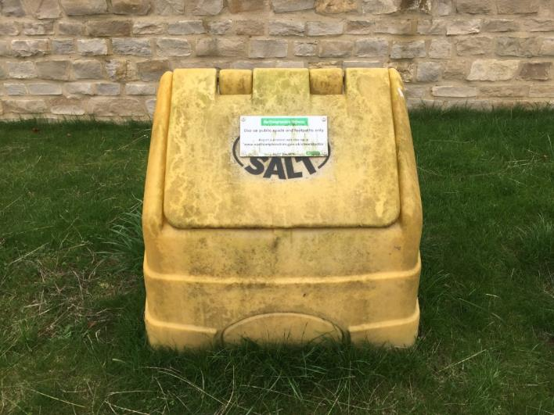
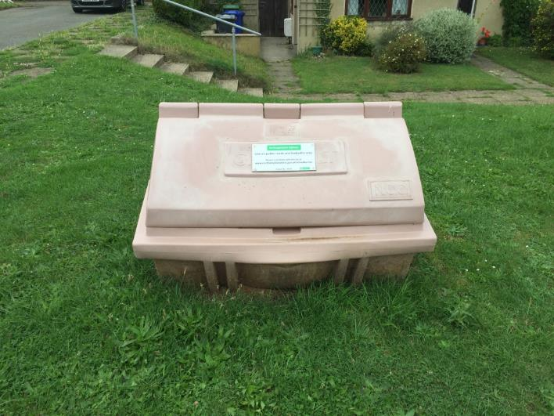
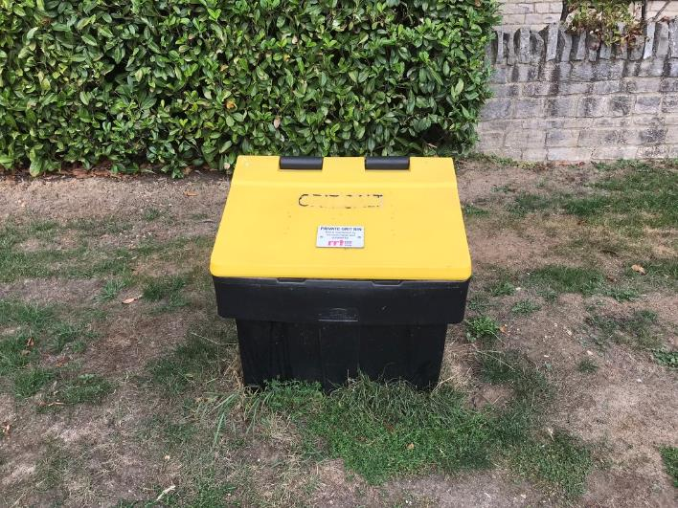
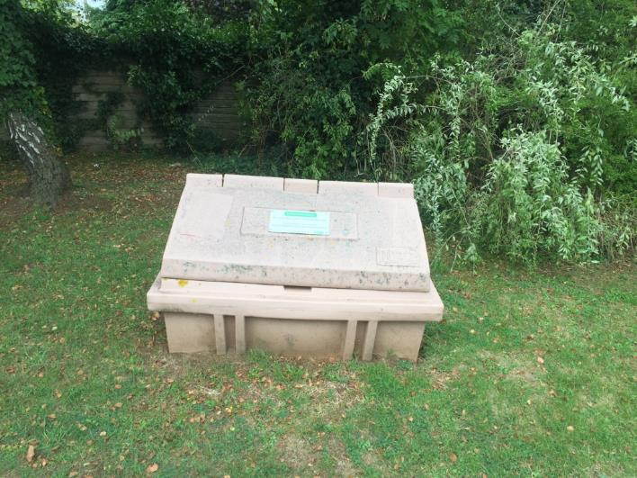
1
3
NCC
ref 1023
EPC
Broad Lane – Opposite Church Leys
School Lane – Opposite Rudgeway
2
4
EPC
EPC
Broad Lane – Opposite Red Lion. Junction of Mixbury Rd/Bicester Hill
Broad Lane – Opposite Lawyers Close

Slide 3
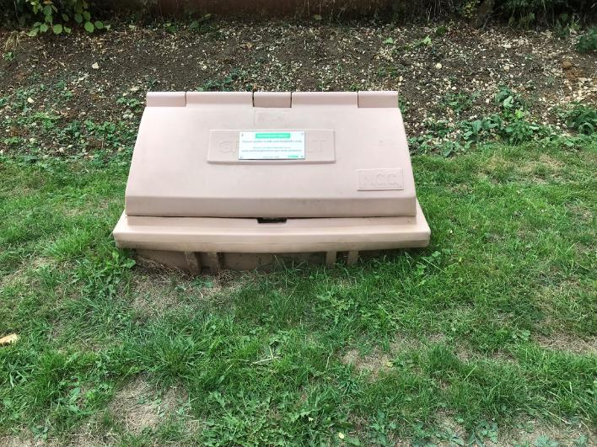
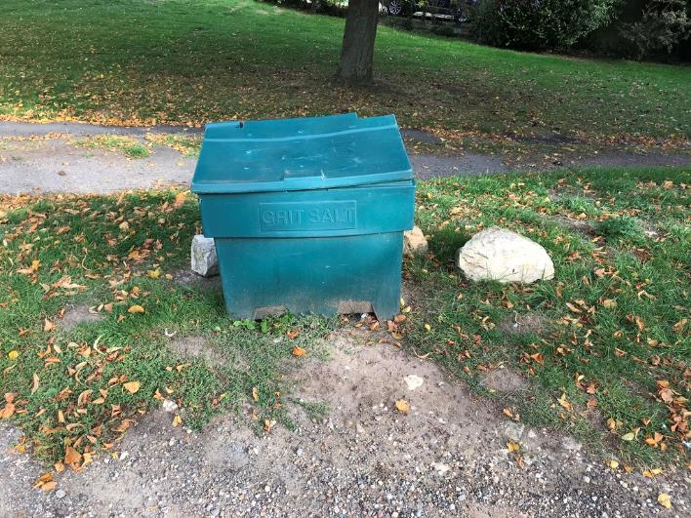
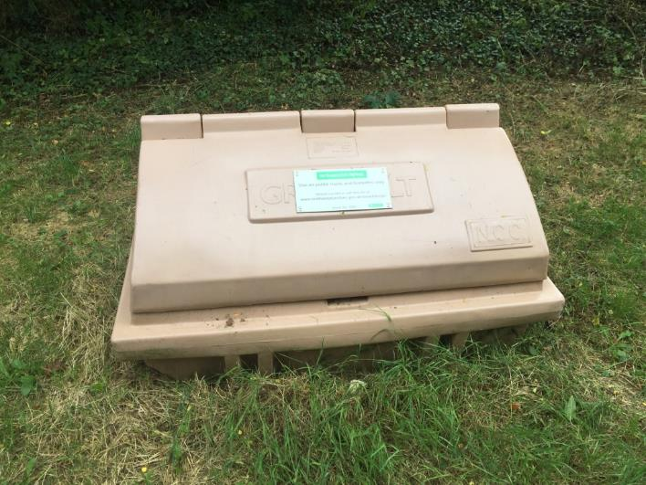
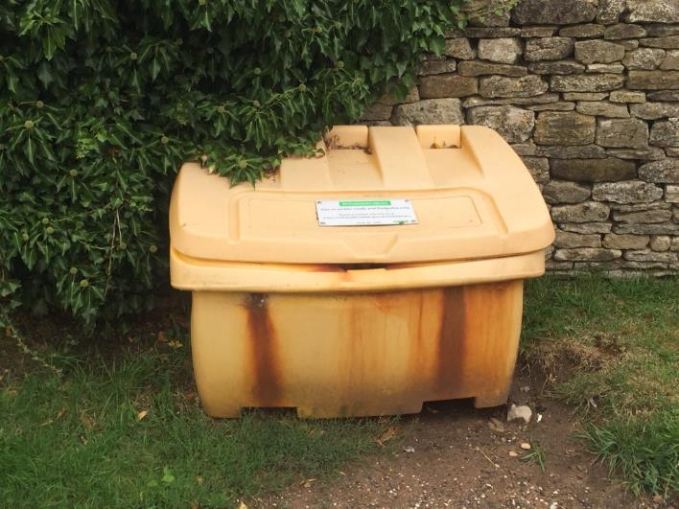
5
7
EPC
EPC
Bicester Hill – Opposite No. 5
The Green – Eastern Corner, opposite No 15
6
8
NCC ref 1021
NCC 1020
Mixbury Road nr 30 mph sign
Church Lane – Opposite Allotments

Slide 4
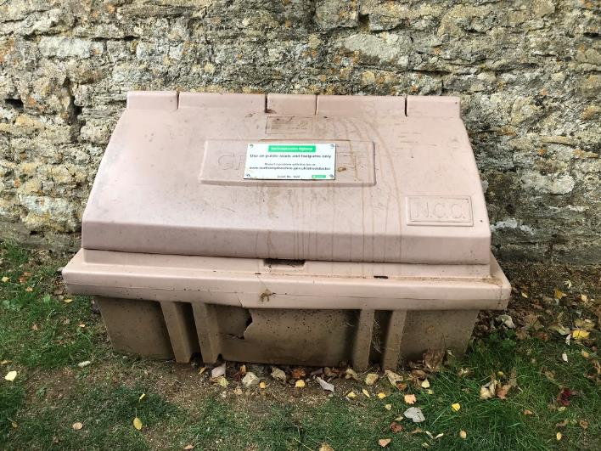
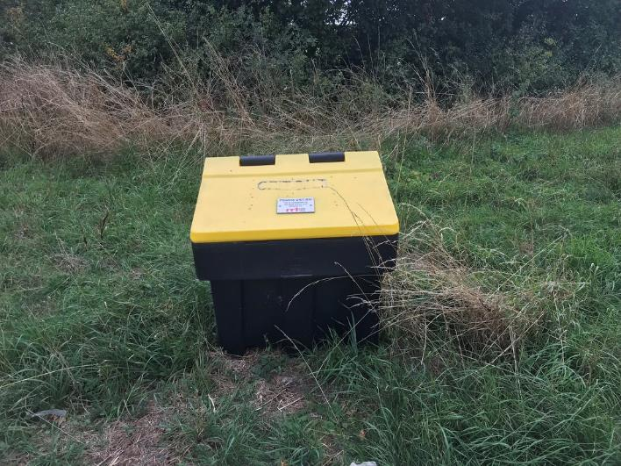
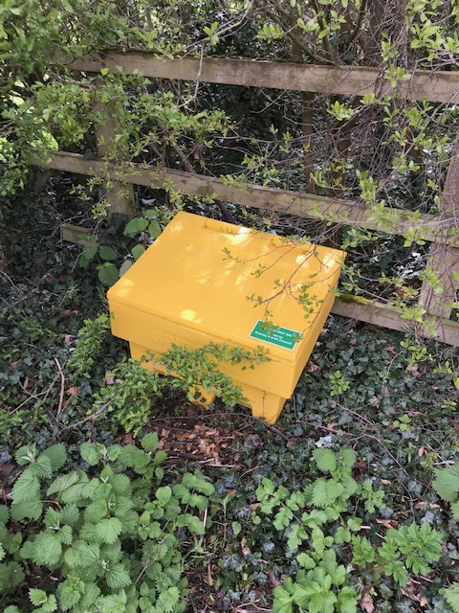
9
No. on map | Ref | Location | Owned by | Comments
1 | EPC | Opposite Church Leys, Broad Lane | EPC | EPC took over Oct 2018
2 | EPC | Opposite Lawyers Close, Broad Lane | EPC | Donated in 2017 Yellow/black
3 | 1023 | School Lane o/s no 12 | WNC | Owned & maintained by West Northants Council
4 | EPC | Mixbury Rd/Bicester Hill Junc Opposite Red Lion | EPC | EPC took over Oct 2018
5 | EPC | Bicester Hill/OS no. 8 | EPC | EPC took over Oct 2018 (was NCC 1018)
6 | 1020 | Mixbury Rd nr 30 mph speed sign | WNC | Owned & maintained by West Northants Council
7 | EPC | Village Green triangle, nr track to sewage works | EPC | EPC owned
8 | 1021 | Nr The Manor, Church Lane, opposite no 2 | WNC | Owned & maintained by West Northants Council
9 | 1022 | Corner by The Barn, Church Lane, near no 17 | WNC | Owned & maintained by West Northants Council
10 | EPC | A421/junction the road leading to Cottisford | EPC | Donated to EPC in 2017. Yellow/black
11 | EPC | Off Charlton Rd (nr Plomers Furze) STOLEN and not replaced. | EPC | Purchased 2021. Since has been stolen.
NCC ref 1022
10
11
A421 / Cottisford, Hethe Road Junction

Slide 5
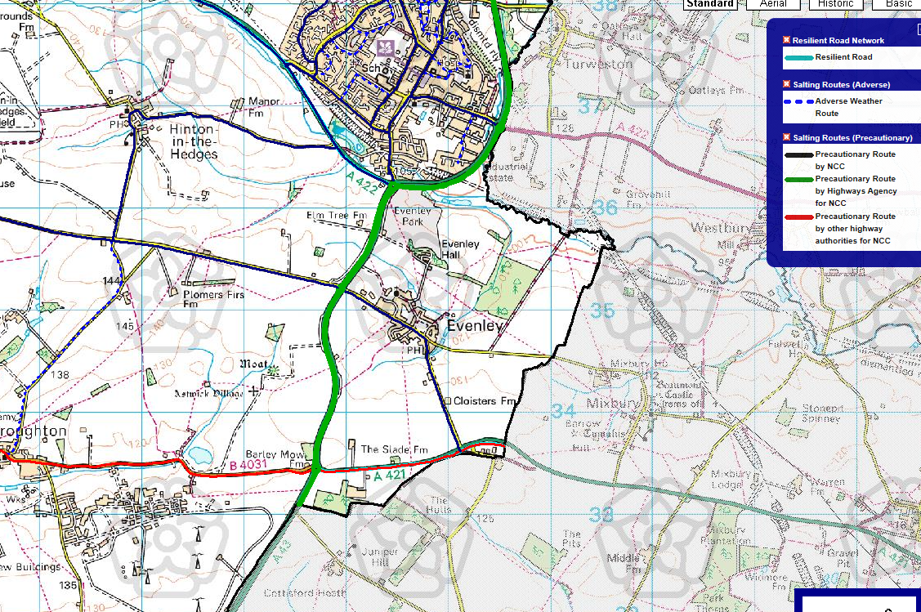

Slide 6
Asset No | Location | Sharp Bend | Junction where there is an approach from a gradient from a side road | Steep Gradient (1 in 10) | Not in precautionary network | Proximity of other bins (within 150m) | Community Facilities | Only access road to community | Total score | NCC will continue to maintain and fill | Notes
 | Range: | 0,1 | 0-2 | 0,1 | 2,0 | -1,0 | 0,1 | 0,1 | Max: 8
EPC 1 | Entrance to Church Leys | 0 | 2 | 0 | 0 | 0 | 0 | 1 | 3 | No | Took over 1024 in 2018
EPC 2 | Entrance to Lawyers close | 0 | 2 | 0 | 0 | 0 | 0 | 1 | 3 | No | Donated new 2017
EPC 3 (NCC 1023) | School Lane O/S no 12 | 0 | 2 | 0 | 2 | 0 | 0 | 1 | 5 | Yes | NCC keep
EPC 4 | Mixbury Road / Bicester Hill Jct | 0 | 0 | 0 | 0 | 0 | 1 | 0 | 1 | No | Took over 1019 in 2018
EPC 5 | Bicester Hill, O/S no 8 | 0 | 0 | 1 | 0 | -1 | 0 | 0 | 0 | No | Took over 1018 in 2018
EPC 6 (NCC 1020) | Mixbury Road near speed Sign | 0 | 0 | 1 | 2 | 0 | 1 | 1 | 5 | Yes | NCC keep
EPC 7 | Village green/sewage works | 0 | 0 | 1 | 2 | 0 | 1 | 1 | 5 | No | Existing EPC
EPC 8 (NCC 1021) | Church Lane opp 2 | 0 | 2 | 0 | 2 | 0 | 1 | 1 | 6 | Yes | NCC keep
EPC 9 (NCC 1022) | Church Lane near 17 | 0 | 2 | 0 | 2 | 0 | 1 | 1 | 6 | Yes | NCC keep
EPC 10 | A421/jnc to Cottisford | 1 | 0 | 0 | 2 | 0 | 0 | 1 | 4 | No | Donated new 2017
EPC 11 | Charlton Road/Plumbers Furze | 0 | 0 | 0 | 0 | 0 | 0 | 1 | 1 | No | Purchased March 2021
For a new grit bin to be placed on the highway network the location must achieve 6 points and all existing bins must achieve 5 points

